Slide 1

Gitflow
Branching and Release
Management
April 23, 2019

Slide 2
What is Gitflow?
Successful branching and release model for Git
Published and Popularized by Vincent Driessen in 2010
Designed around Project Releases and Iterative Development
Ideal for projects with a scheduled release cycle

Slide 3
Why Gitflow?
So, you’ve deployed a Microservice to Production that encapsulates a business capability… now what?
Supporting and Maintaining an API in Production
How do you use Semantic Versioning as an API versioning strategy? (Current EA Guidance)
How do you evolve the API and add new functionality to the existing capability but still achieve an API that is backwards-compatible as stable as possible?
How do you manage and deploy hotfixes to a production release while ensuring that those fixes are never lost during development?
How does your development team work in parallel with regards to API features, and how do those features make it into a planned release?
After features have been developed, how do you create and stabilize a release prior to production?
How do you deploy a branch (feature, hotfix, or release) to an environment so that no matter what the change is, it goes through the regular development life cycle?
Development -> Integration -> System Test -> Project UAT -> Integrated UAT -> Production

Slide 4
Key Benefits
Built-in support within Git
Parallel Development
Faster and more Frequent Releases
Best Practices in Release Management
Support for Semantic Versioning API Strategy
Feature Planning and Development
Production Release Stabilisation
TFS Integration and Iteration Planning
Support for Emergency Fixes
Tooling and Release Automation

Slide 5
Aside: Semantic Versioning
Format: MAJOR.MINOR.PATCH
Each version number increment has a meaning
MAJOR upgrade – breaking change
MINOR upgrade – feature upgrade, but backwards compatible
PATCH upgrade – patch or bug fix
Example
1.0.0 – Initial release
1.0.1 – Security patch
1.0.2 – Bug fixes to initial release
1.1.0 – Added a new feature (backwards compatible with 1.0)
1.1.1 – Fixed bug with the new feature
1.2.0 – Added another new feature (backwards compatible with 1.0 and 1.1)
1.2.1 – General bug fixes (applies to all versions)
2.0.0 – Completely re-written API from the ground-up. Introduces breaking change.

Slide 6
Aside: Semantic Versioning of APIs
MAJOR Upgrade – Incompatible (breaking) API changes
MINOR Upgrade – Add API functionality (backwards-compatible)
PATCH Upgrade – Bug fixes to existing API

Slide 7
Aside: Backwards Compatibility
Backwards-compatible (non-breaking) changes
Adding an API interface to an API service
Adding a method to an API interface
Adding an HTTP binding to a method
Adding a field to a request message
Adding a field to a response message
Adding a value to an enum
Adding an output-only resource field
Backwards-incompatible (breaking) changes
Removing or renaming a service, interface, field, method or enum value
Changing an HTTP binding
Changing the type of a field
Changing the proto field number
Changing a resource name format
Changing visible behavior of existing requests
Changing the URL format in the HTTP definition
Adding a read/write field to a resource message

Slide 8

Branching Model
Two long living branches
Develop
Master
Transient Feature Branches
Feature 1
Feature 2
Etc
Transient Release Branches
Release 1.0.0
Release 1.1.0
Release 1.2.0
Transient Hotfix Branches
Hotfix/Patch 1.0.1

Slide 9
How it Works
Feature Development
Release Management
Managing Hotfixes

Slide 10
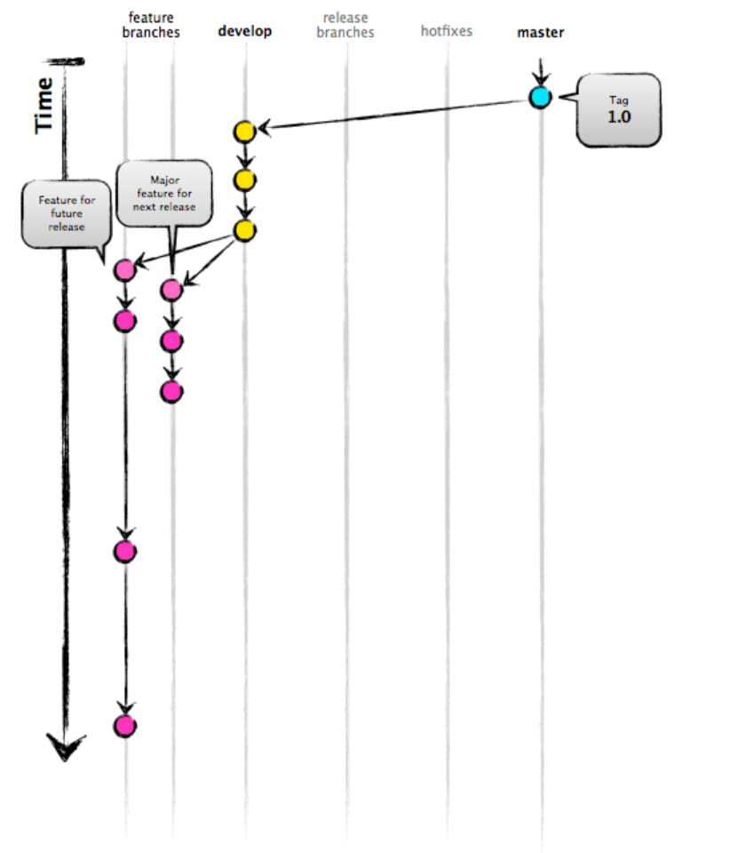
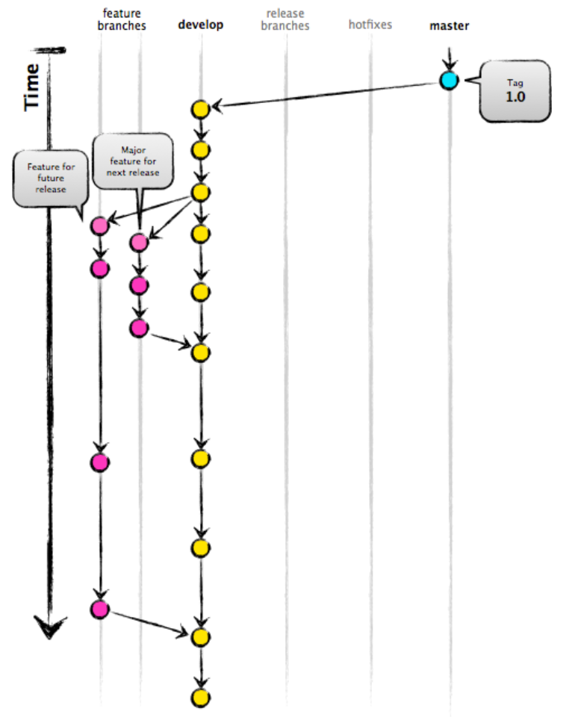
Feature Development
Branch Naming Convention
features/<name>
Start Feature
Create Feature Branch from Develop branch (i.e. features/feature-1)
Deploy to environment
Iterate over develop-deploy-test
Finish Feature
Merge Feature Branch back into Develop when ready for release
Cleanup and Destroy Feature Branch
Start Feature
Finish Feature

Slide 11
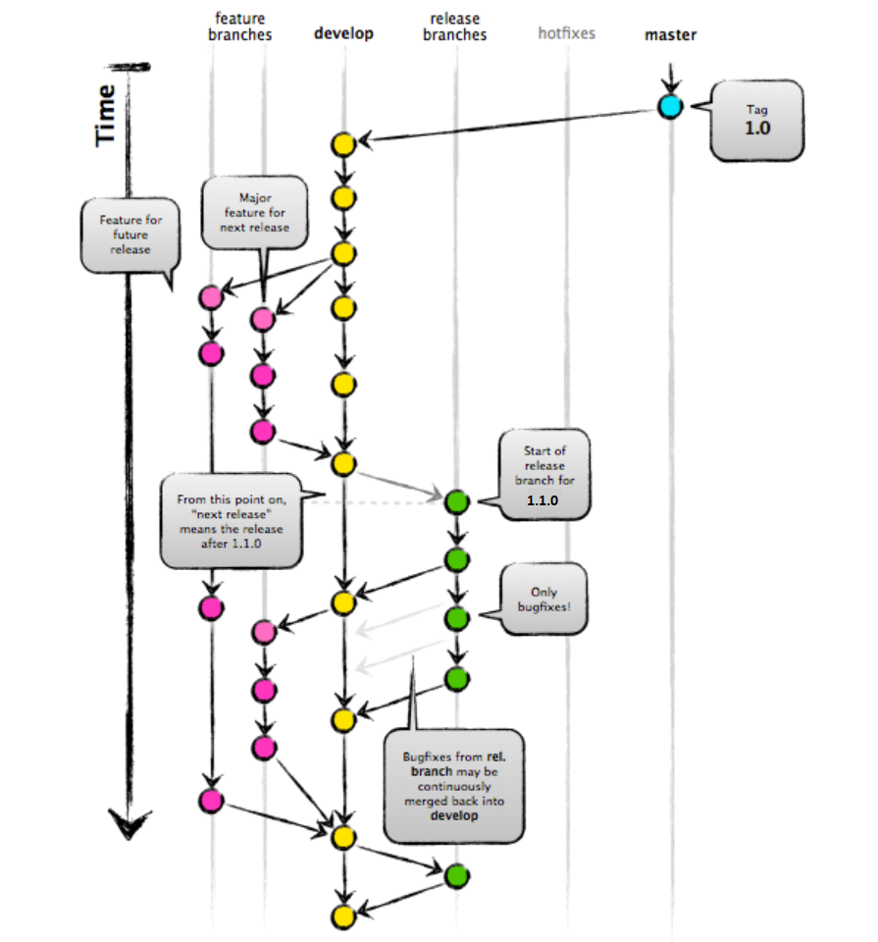
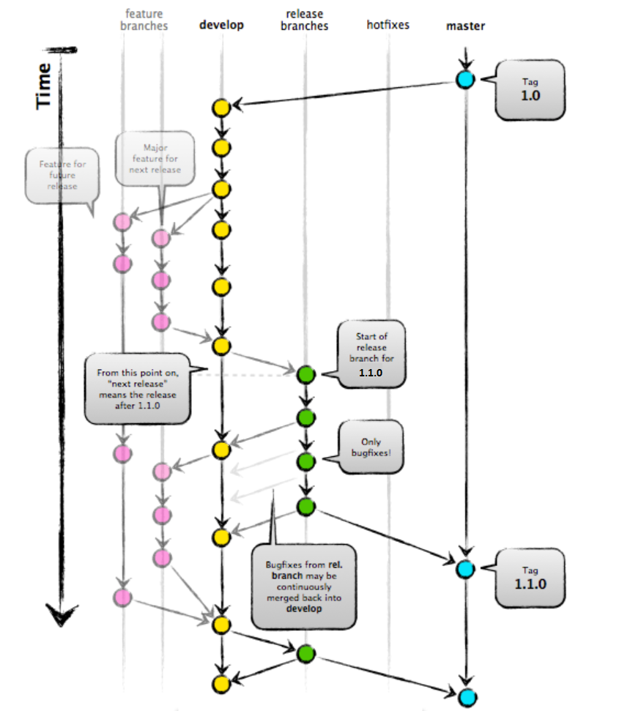
Release Management
Branch naming convention:
releases/<name>
Feature Set is frozen: only Bugfixes make it into a Release!
Start Release
When it is time to make a release, a release branch is created off of develop
i.e. releases/1.1.0
Finish Release
When the release is finished, the release branch is merged into master and into develop to make sure fixes are not lost
Cleanup and Destroy Release Branch
A release tag is created on Master (i.e. 1.1.0)
Example
releases/1.1.0
Start Release
Finish Release

Slide 12
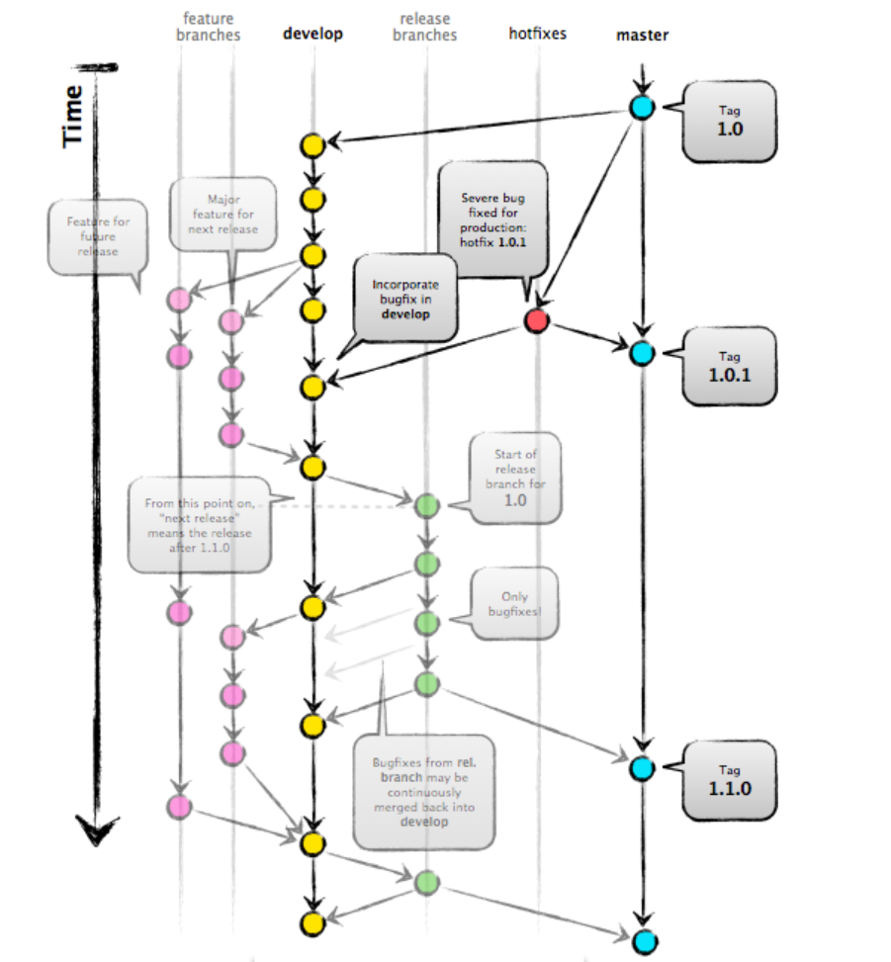
Managing Hotfixes
Hotfix branches are used to create emergency fixes
Branched directly from a tagged release in the master branch
When finished, merged back into both master and develop to make sure hotfix is not lost.
Hotfixes are Tagged as patch upgrades (i.e. 1.0.1)

Slide 13
To Summarize…
Two long lived branches: Master and Develop
Feature development occurs on Feature branches, which is always created from the Develop branch
New functionality (1.2.0)
Only Bug fixes (1.1.1)
New functionality and bug fixes (1.2.0)
Release management occurs on Release branches, which is always created from the Develop branch
Feature set is frozen
Only bug fixes are allowed
Stabilises a release
Hotfixes on Hotfix branches, which is always created from the Master branch
Only bug fixes are allowed
Stabilises a release
Fixes from Release and Hotfix branches are always preserved on the Develop branch

Slide 14
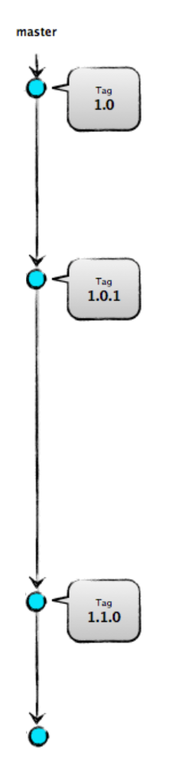
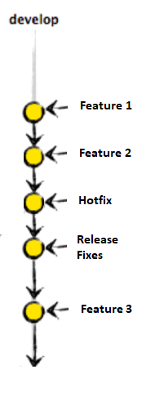
Branch Commits
Master branch contains
Merges from Release and Hotfix branches
Clean merge history
Contains only Release Tags (1.1.0, 1.2.0, 1.2.1) and Hotfix Tags (1.2.2, 1.2.3)
Develop branch contains
Merges from Feature, Release, and Hotfix branches

Slide 15
Built-in Support for Git Flow
Commands
git flow init → initialize a new git repo with support for the branching model
git flow feature → manage your feature branches
git flow bugfix → manage your bugfix branches
git flow release → manage your release branches
git flow hotfix → manage your hotfix branches
git flow support → manage your support branches
git flow version → shows version information
git flow log → show log deviating from base branch

Slide 16
Demo

Slide 17
Demo
Initializing Git Flow
git flow init
Developing Features
git flow feature start <name>
git flow feature finish <name>
Bug fix branches
git flow bugfix start <name>
git flow bugfix finish <name>
Release Branches
git flow release start <major.minor.patch>
git flow release finish <major.minor.patch>
Hotfix Branches
git flow hotfix start <major.minor.patch>
git flow hotfix finish <major.minor.patch>

Slide 18
Questions

